Slide 3
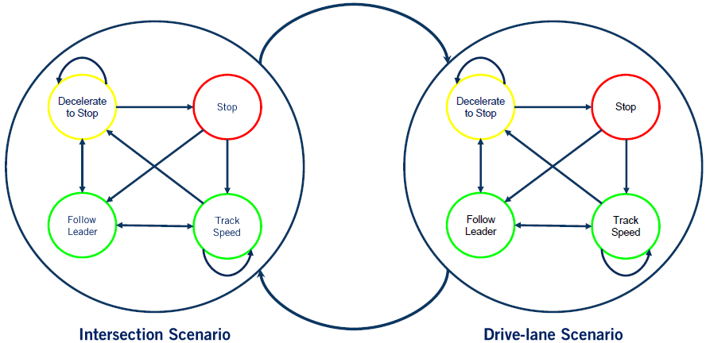
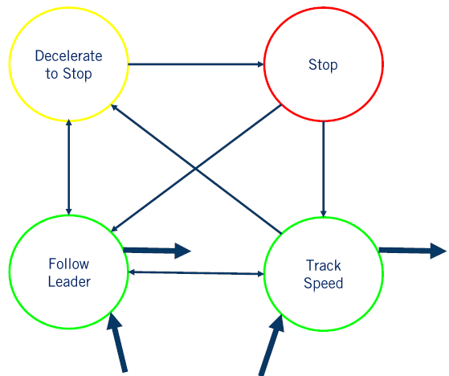
DELETE Handling Multiple Scenarios with Hierarchical FSM
Each driving scenario is modeled as a super-state, which contains a low-level FSM for the scenario.
(Each low-level FSM is specific for the scenario, e.g., the two FSMs in the figure have different trigger conditions not shown)
Exit
transitions
Entry transitions

Slide 4
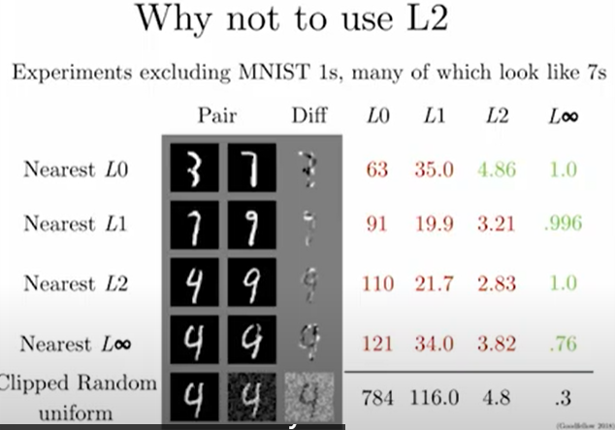
Defense Against the Dark Arts
https://www.youtube.com/watch?v=KNDkaVZwmg4&list=PL0pRF4xvoD0liEIWyJ6kmXqGT7nbr2L3u&index=11
Diagonal is minimum norm. Ideally, we want norm distance to be large for class-changing perturbations, small for random noise, like Linfty. But adding random noise leads to L2 norm 4.8, bigger than many class-changing perturbations. NG.
L2 norm cannot detect/permits change of a few pixels largely, which is likely to change the class.
We can make L2 distance big while still preserving the class

Slide 5
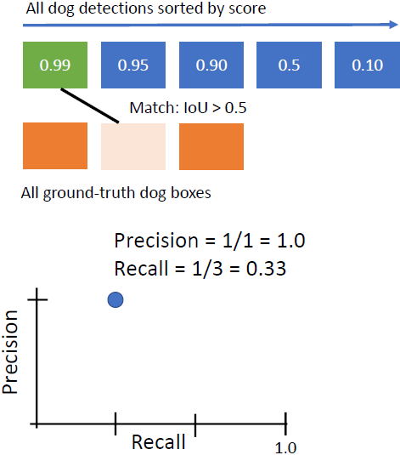
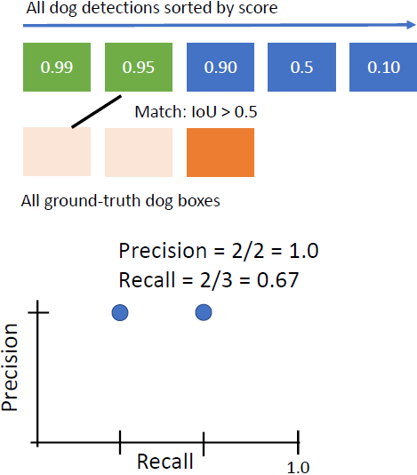
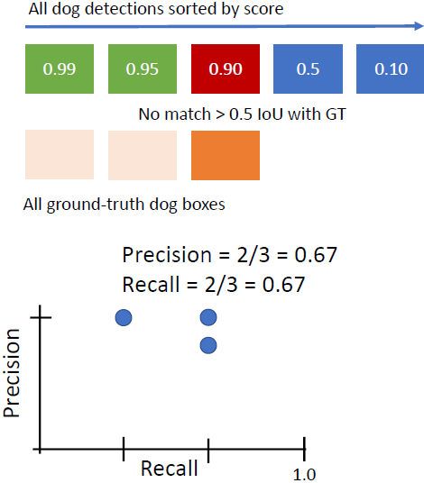

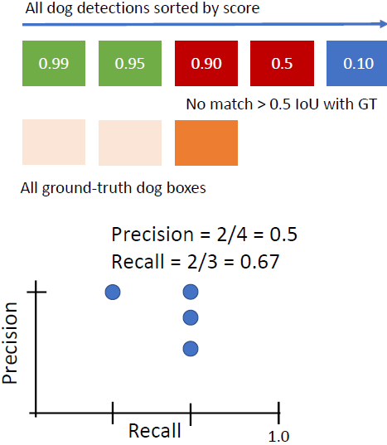
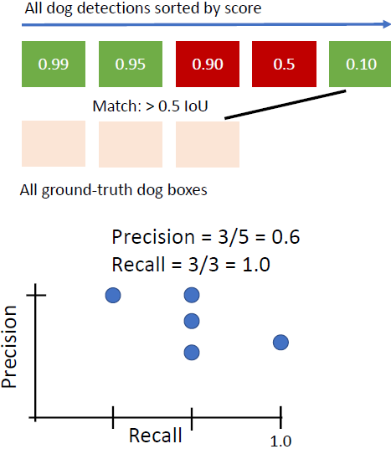
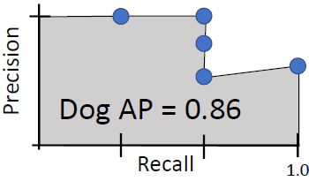
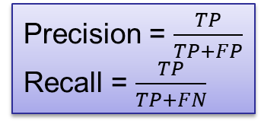
If you have a 3rd GT box that is not matched by any detection, then it is FN. But I don’t see any possible TN
FN=2 | TN=0
TP=1 | FP=0
FN=1 | TN=0
TP=2 | FP=0
FN=1 | TN=0
TP=2 | FP=1
FN=1 | TN=0
TP=2 | FP=2
FN=0 | TN=0
TP=3 | FP=2
Precision = $\frac{TP}{TP+FP}$
Recall = $\frac{TP}{TP+FN}$

